Slide 1

MUSIC STORE MANAGEMENT SYSTEM
SUBMITTED BY :
AMBATI SHIVA
PATURI MADHU

Slide 2
Agenda
Introduction
Problem Statement
Objective of the Project
ER Diagram and schema explanation
Key analysis questions (use cases)
SQL query results with screenshots or summaries
Final business insights and recommendations
Conclusion (Key finding overall)
Your Experience/Challenges working on SQL – Data Analysis Project.

Slide 3
Introduction
The music industry produces vast amounts of data related to customers, artists, albums, and sales every day. Managing and analyzing this information is essential for improving performance and understanding customer preferences. Without a proper system, this data remains scattered and difficult to use effectively.
The Music Sotre Management System aims to organize and store all music-related information in a single, well-structured relational SQL database. It connects key entities such as artists, albums, tracks, genres, employees, customers, and invoices, ensuring data consistency and easy retrieval.
Through this project, various SQL queries and analytical operations are used to generate insights like identifying top customers, best-selling artists, popular genres, and cities generating the highest revenue.
Overall, the project highlights how SQL-based database design and analysis can transform unorganized data into useful business insights for better decision-making and operational efficiency.

Slide 4
Problem Statement
In today’s digital music industry, managing large volumes of data about artists, albums, tracks, customers, and sales is a major challenge. The data is often scattered, making it difficult to analyze performance, customer behavior, and revenue trends. To address this issue, a Music Store Management System is designed to store and manage all music-related data in a structured and centralized manner.
The project focuses on creating a relational SQL database that connects key entities like employees, customers, artists, albums, invoices, and playlists. It aims to simplify data retrieval and provide insights into business performance. Through SQL queries and analytical techniques, the project helps identify top customers, best-selling artists, popular genres, high-revenue cities, and senior employees.
.

Slide 5
Objective of the Project:
To design and implement a relational database for a music store.
To apply SQL concepts (joins, aggregations, subqueries) on real-world data.
To analyze customer behavior, sales trends, and music preferences.
To generate insights that support business decisions like promotions, top customer targeting, and popular genre focus.

Slide 6
Schema Tables & Relationships:
Customer – Invoice – Invoice Line – Track – Album – Artist – Genre – MediaType form the sales and music hierarchy.
Employee – Customer link for support representatives.
Playlist – Playlist Track – Track manage curated lists.
Key Relationships
Customer → Invoice → Invoice Line → Track → Album → Artist → Genre.
Employee → Customer (support rep).
Many-to-many handled through Playlist Track.

Slide 7
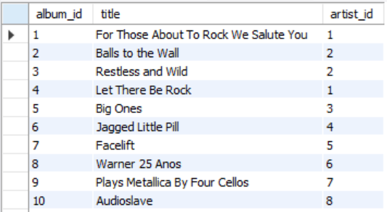
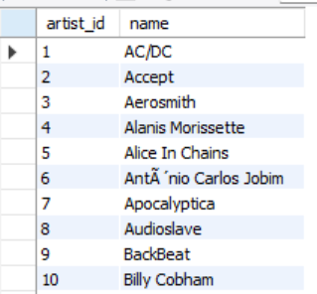
Tables
Albumn Artist

Slide 8
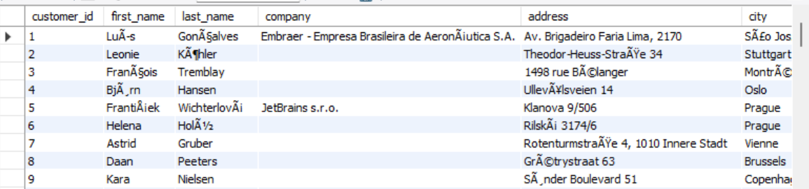
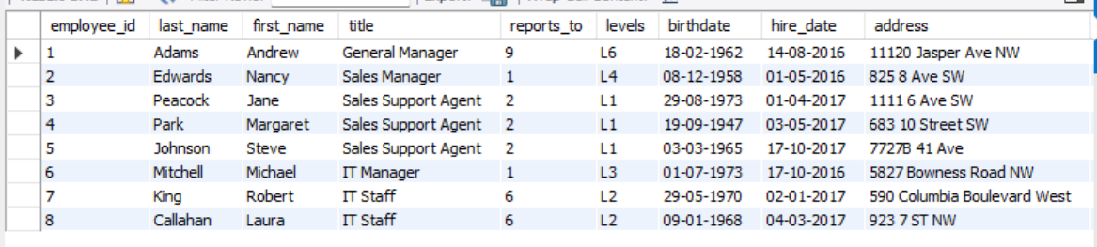
Tables
Customer Employee

Slide 9
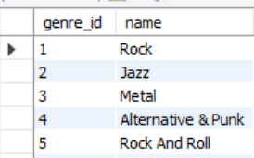
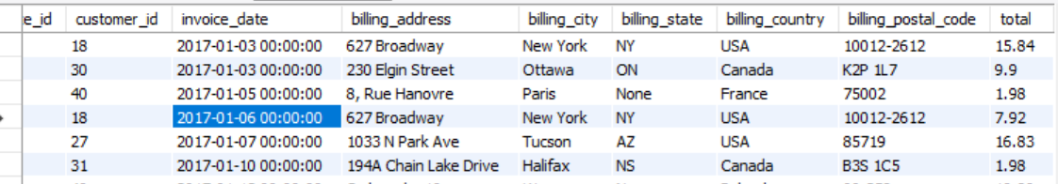
Tables
Genre Invoice

Slide 10
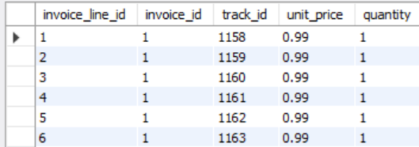
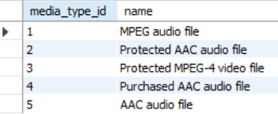
Tables
Invoice_line Media type

Slide 11
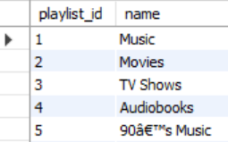
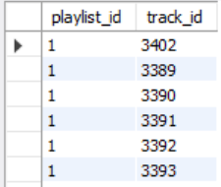
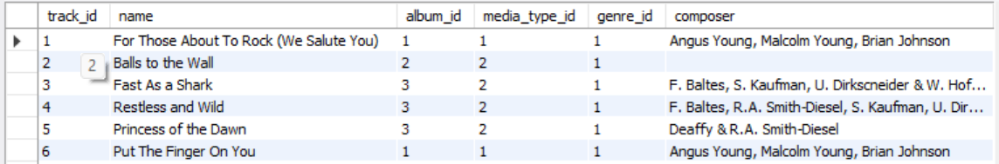
Tables
Playlist Playlist_track Track

Slide 12
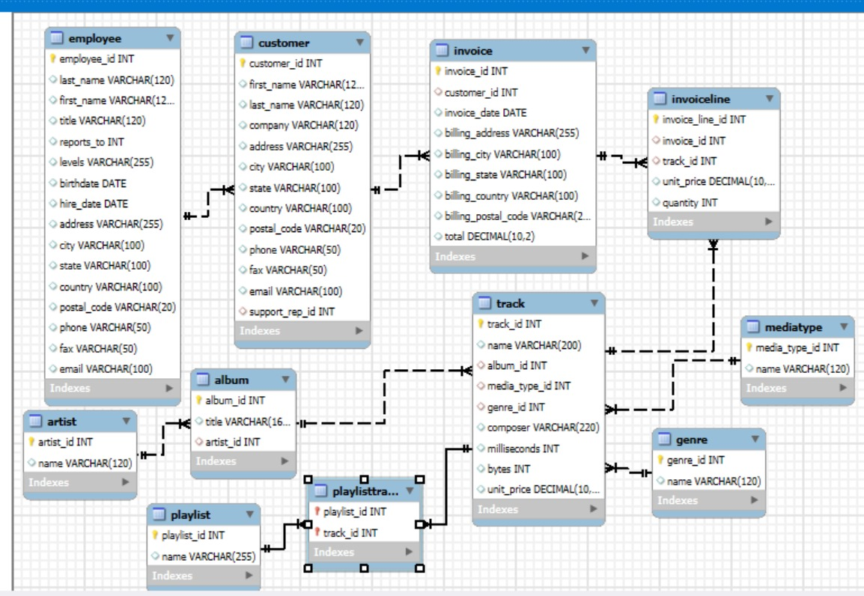
ER Diagram:

Slide 13
Key analysis questions (use cases):
Find the senior-most employee based on job title?
Which countries generate the most invoices?
Which are the top 3 invoices by total value?
Which city has generated the most revenue from invoices?
Who is the best customer overall?
List all Rock music listeners with their email, name, and genre?
Which 10 artists have the most Rock tracks?
Tracks longer than avg song length?
How much has each customer spent on each artist?
Who is the top-spending customer in each country?
Most popular music genre by country.

Slide 14
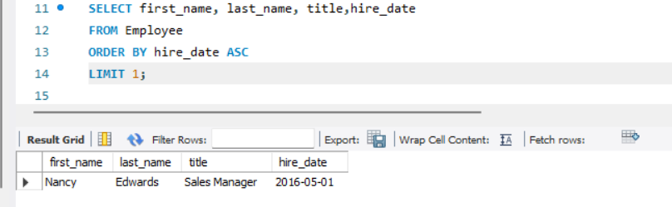
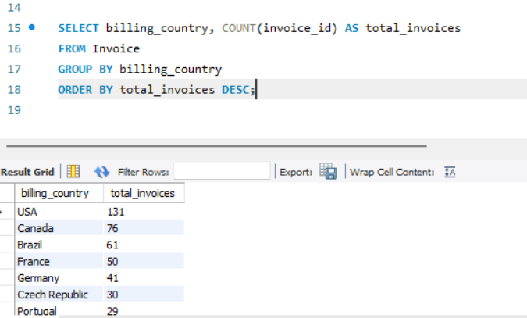
SQL query results with screenshots:
1. Senior most employee based on job title: 2. Count invoices per country:

Slide 15
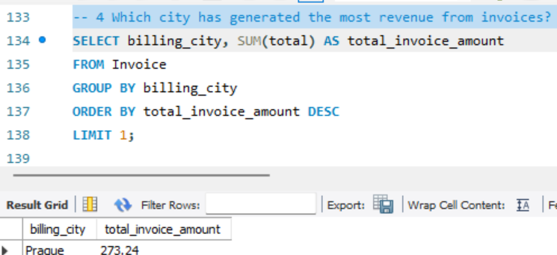
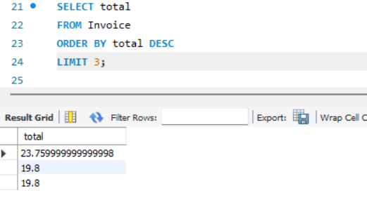
3. Top 3 invoices total: 4. City with highest total invoice amount:

Slide 16
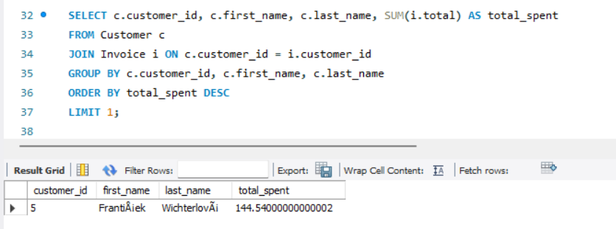
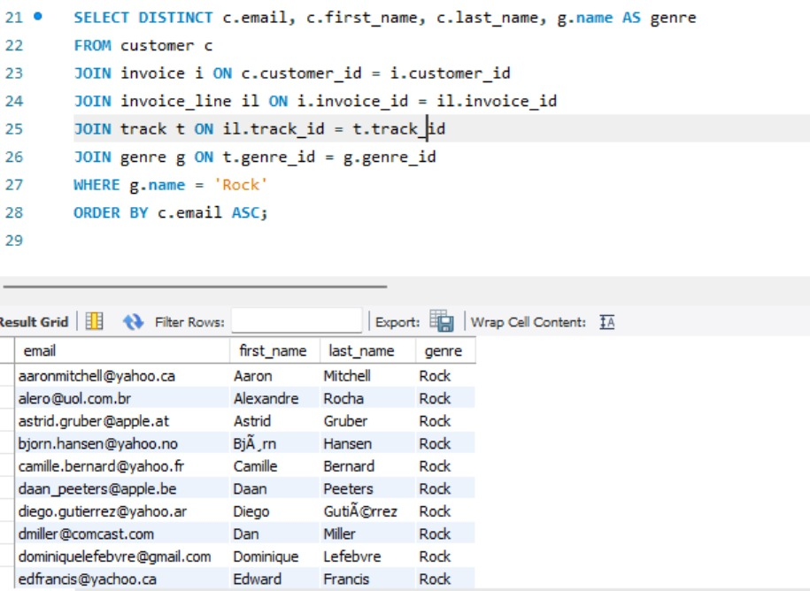
5. Customer who spent the most: 6. Rock music listeners:

Slide 17
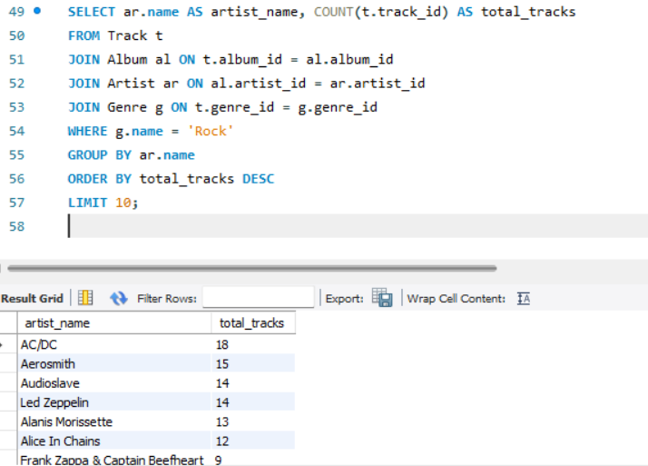
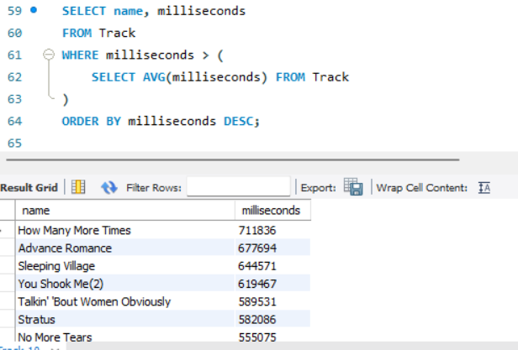
7. Top 10 rock artists by track count: 8. Tracks longer than avg song length:

Slide 18
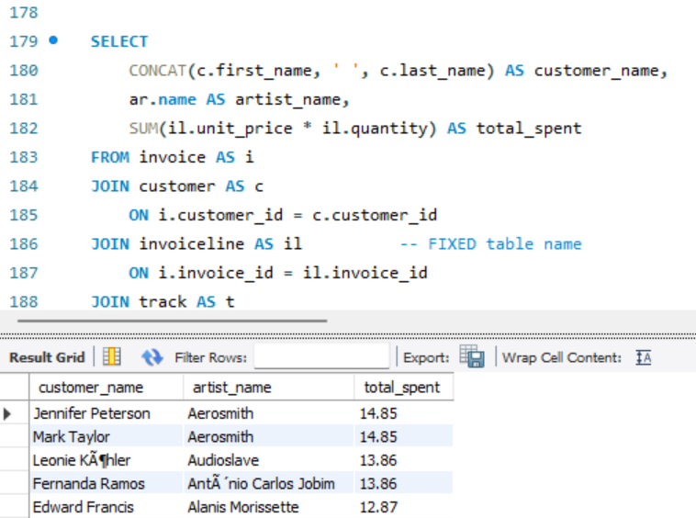
9. Amount spent by each customer on each artist:

Slide 19
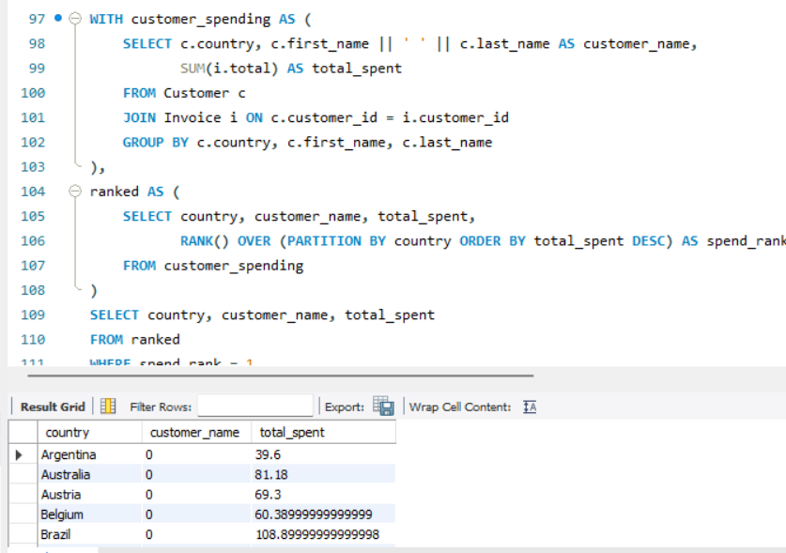
10. Customer who spent the most per country:

Slide 20
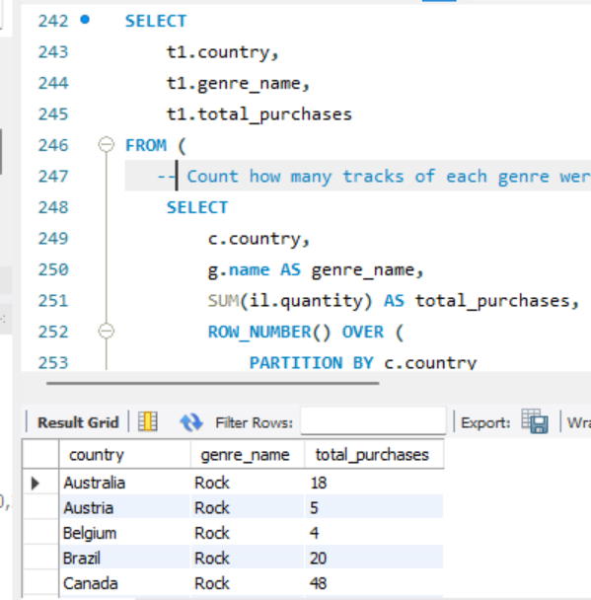
11. Most popular genre per country:

Slide 21
Final business insights and recommendations:
Revenue Concentration: Few countries and cities generate most revenue. Focus marketing there.
Customer Segmentation: A handful of high-value customers drive sales → target with loyalty programs.
Genre Trends: Rock is globally most popular. Promote Rock-focused albums/events.
Artist Promotion: Top artists contribute heavily; underperforming artists may need discounts/promotions.
Geographical Strategy: Organize festivals in top-spending cities (e.g., Prague).

Slide 22
Conclusion (Key finding overall):
Rock is the dominant genre across multiple countries.
Few customers (VIPs) contribute to majority of sales.
Certain cities/countries are hotspots for revenue.
SQL analysis helps in identifying who, what, and where to focus business strategies.

Slide 23
Experience & Challenges:
Experience:
Applied SQL joins, subqueries, aggregations on a real dataset.
Learned database design and relational schema building.
Challenges Faced:
Handling large CSV imports (track, invoice Line).
Understanding foreign key relationships while writing joins.
Aggregating across multiple tables for business logic (top customer/genre).
Outcome:
Improved confidence in SQL.
Ability to derive insights from raw relational data.

Slide 24

THANK YOU

